Slide 1
Introduction to Agile Development
Agile vs Traditional
Scrum

Slide 2
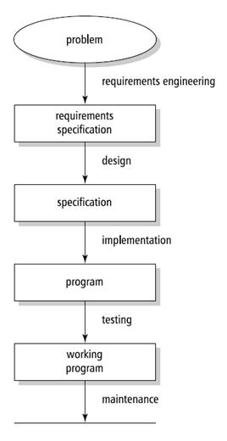
Traditional Methodologies
aka Predictive or Linear
Sequential series of steps
Depends on an idealized reality
Document or plan-driven
  Requires a stable and complete set of
  requirements
Typical traditional methodologies are
  Waterfall, V-Model, Spiral and RUP

Slide 3
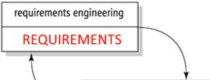

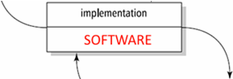
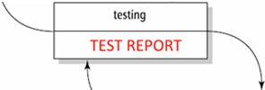

Waterfall Model
Still used!
Customer heavily involved at the beginning of the life cycle
Heavyweight, document-driven
  ­Emphasis on careful analysis
  ­Success relies on knowing all requirements
Each milestone is linked to a certain artefact

Slide 4
Waterfall Artefacts
Requirements Specification
Complete Design Documentation
Complete Code
User Manual

Slide 5
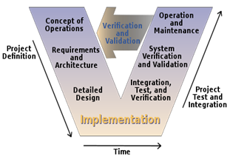
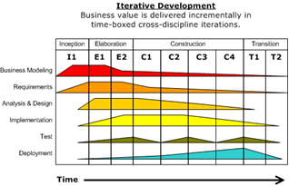
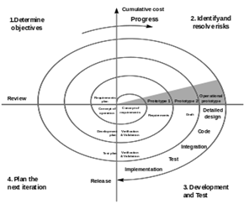
Extended Traditional Models
Spiral-Iterative
V-Model
Iterative Development

Slide 6
Agile
Because Waterfall doesn't work in many cases

Slide 7
Agile Values
Agile Manifesto
(Kent Beck et al. 2001)
“Individuals and interactions over processes and tools
Working software over comprehensive documentation
Customer collaboration over contract negotiation
Responding to change over following a plan”

Slide 8
Agile Principles
Our highest priority is to satisfy the customer
through early and continuous delivery
of valuable software.
Welcome changing requirements, even late in
development. Agile processes harness change for
the customer's competitive advantage.

Slide 9
Agile Principles
Deliver working software frequently, from a
couple of weeks to a couple of months, with a
preference to the shorter timescale.
Business people and developers must work
together daily throughout the project.

Slide 10
Agile Principles
Build projects around motivated individuals.
Give them the environment and support they need,
and trust them to get the job done.
The most efficient and effective method of
conveying information to and within a development
team is face-to-face conversation.

Slide 11
Agile Principles
Working software is the primary measure of progress.
Agile processes promote sustainable development.
The sponsors, developers, and users should be able
to maintain a constant pace indefinitely.

Slide 12
Agile Principles
Continuous attention to technical excellence
and good design enhances agility.
Simplicity--the art of maximizing the amount
of work not done--is essential.

Slide 13
Agile Principles
The best architectures, requirements, and designs
emerge from self-organizing teams.
At regular intervals, the team reflects on how
to become more effective, then tunes and adjusts
its behaviour accordingly.

Slide 14
Agile Principles

Slide 15
Agile
That's it
Agile is really just a different mind-set or paradigm
Making it actually work requires additional structure:
  Practices
  Tools
  Artifacts
  Disciplines

Slide 16





Customer Involvement
Management
Development Team
Customer
“all players—the sponsor, customer, user, and developer—are on the same team”

Slide 17
You are not only a programmer
All-rounder needed!
Communication
Problem solving
Self-organisation
Self-evaluation
Regular Meetings
Teamwork
Software Design
Programming
Testing
“Team proximity and intense interaction between team members is a hallmark of all
agile methods”

Slide 18
Declaration of Interdependence
Six project management principles that were formulated after the Agile Manifesto
  We Increase return on investment by making continuous flow of value our focus.
  We Deliver reliable results by engaging customers in frequent interactions and shared ownership.
  We Expect uncertainty and manage for it through iterations, anticipation and adaptation.
  We Unleash creativity and innovation by recognizing that individuals are the ultimate source of value and creating an environment where they can make a difference.
  We Boost performance through group accountability for results and shared responsibility for team effectiveness.
  We Improve effectiveness and reliability through situationally specific strategies, processes and practices
https://en.wikipedia.org/wiki/PM_Declaration_of_Interdependence

Slide 19
Scrum
Scrum is the most popular form of Agile
Scrum has some formalized rules

Slide 20

Scrum has "Roles"
Product Owner
Development Team
Scrum Master
Represents business and user interests
Creates and manages requirements
Sets priorities for increments
Scrum expert with experience
Guides the team with Scrum
NOT the manager!
Multi-disciplinary team
Create estimates
Responsible for delivering increments

Slide 21
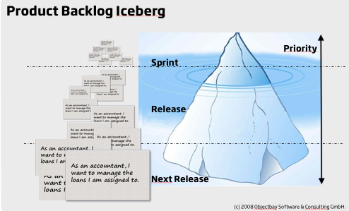
Iceberg

Slide 22
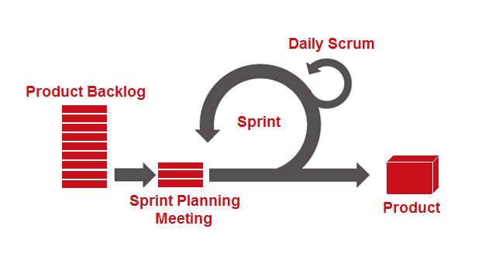
Scrum has a Process
Notes:
Scrum Diagram
Figure 1. Kishore Gaddam, (2012), Pictorial representation of the Scrum development. [ONLINE]. Available at: http://kishore1021.files.wordpress.com/2012/07/image25.png [Accessed 20 October 14].
Cohn, M. 2006, "Iteration Planning" in Agile estimating and planning, 7th edn, Prentice Hall, Upper Saddle River, NJ, pp. 151-152.
Schwaber, K. 2002, "Daily Srum Meetings" in Agile software development with Scrum Pearson Prentice Hall, Upper Saddle River, N.J., pp. 31-40.
Anderson, D.J. 2004, "The Sprint Review" in Agile management for software engineering : applying the theory of constraints for business results, ed. P. Coad, 8th edn, Prentice Hall Professional Technical Reference, Upper Saddle River, NJ ; London], pp. 263.

Slide 23


Slide 24
Other Agile variants
Extreme Programming
Kanban
Lean
DSDM
Crystal Methods
Etc.
More on this later…

Slide 25
So why is Waterfall still used?
Agile is hard to do well
  Requires a lot of discipline
  Working in fixed time boxes
  Estimating in relative units
Customer communication
Continuous development
Team collaboration
Some projects are too complex
  Air traffic control
  Autonomous vehicles
  Military
Not always a good fit
  Rigid constraints
  Inexperienced team
  Lots of different teams

Slide 26
Introduction to Agile Development
Agile vs Traditional
Scrum

